Slide 1

Bellabeat’s Report
An analysis about health smart products
by Renato Barbosa

Slide 2
Contents
1.Question
2.Business Task
3.Data collection
4.Data Preparation
5.Data Analysis/ Conclusions
6.Recommendations

Slide 3

1.Question
How to improve our device?

Slide 4
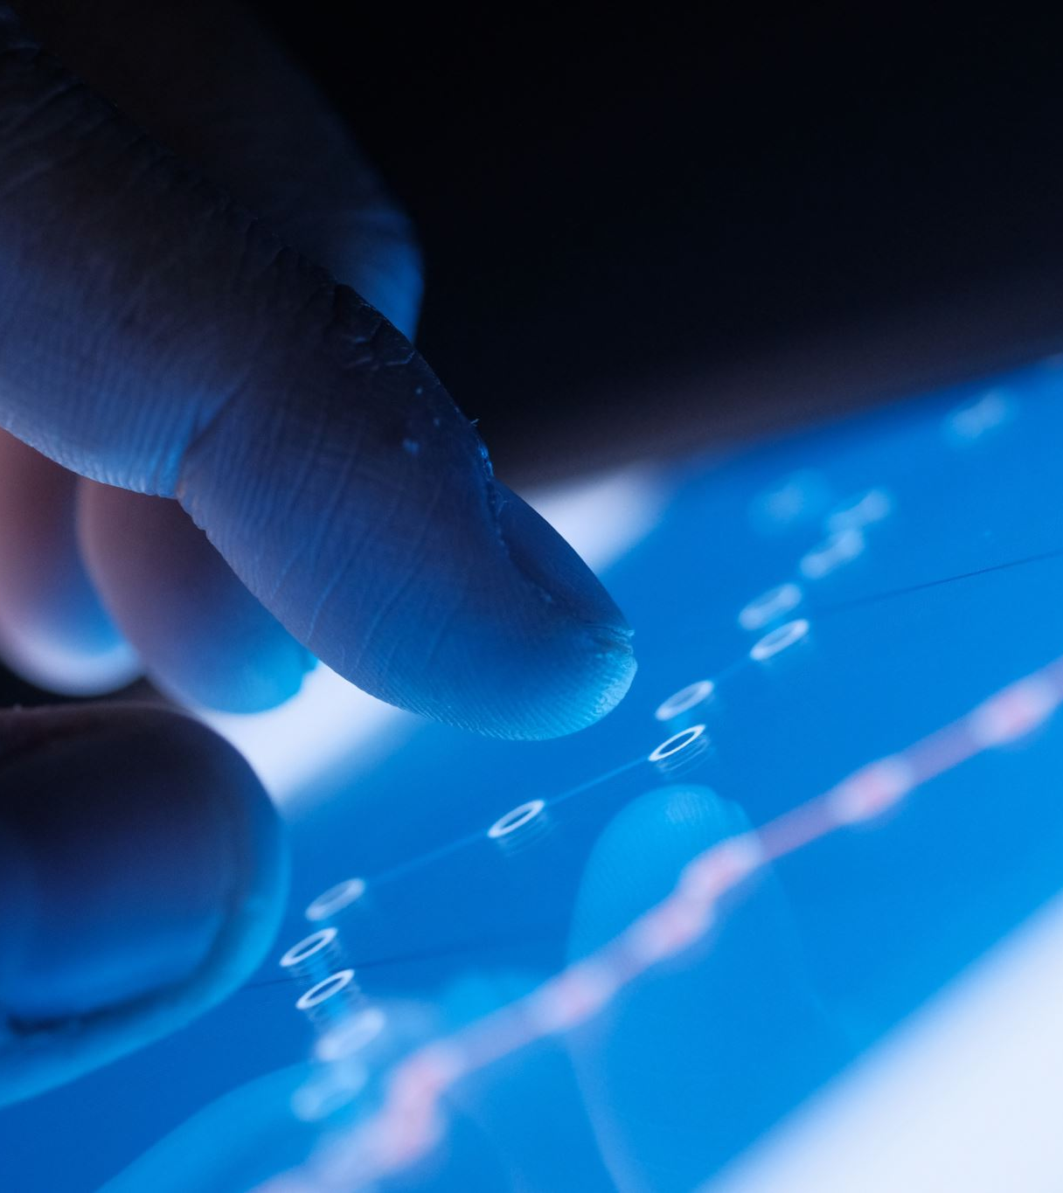
2.Business Task
Analysis over the existing market of intelligent devices
Create insights
Improve performance and product delivery to our customers
Grow Bellabeat’s market steak

Slide 5
3. Data collection
A public sample of 33 individuals published on Kaggle
Data in a long format about daily records
Information about activity, sleep, weight, heart rate,…
Recorded by smart devices
Data-Frame: 12 Abril 2016 to 12 May 2016

Slide 6

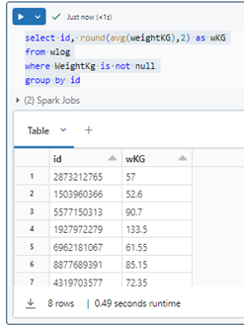
4.Data Preparation
Removal of duplicates and errors
Query data in SQL using Databricks to create new metric tables:
Avg activity
Avg heart rate
Avg sleep
Avg weight

Slide 7
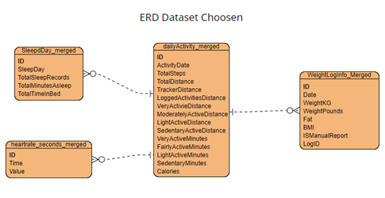
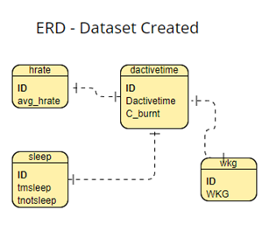
4.Data Preparation

Slide 8
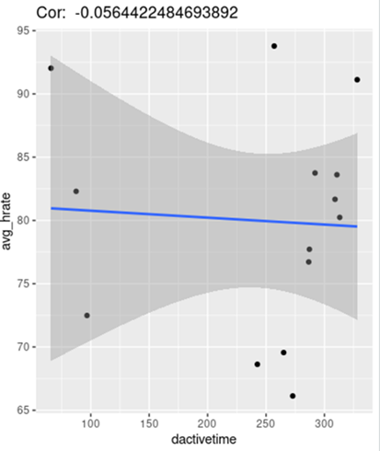
4. Data Preparation
Using R
> install.packages("tidyverse") # Installing tidyverse
> library(tidyverse) # Uploading
>c1hrate_actime <- inner_join(dactivetime, hrate, by = "id") # Creating a table with heart rate and activity
> str(c1hrate_actime) spc_tbl_ [14 × 4] (S3: spec_tbl_df/tbl_df/tbl/data.frame) # Basic stats
> ggplot(data=c1hrate_actime, aes(x=dactivetime, y=avg_hrate))
+ geom_point()
+ geom_smooth(method='lm', formula='y~x')
+ ggtitle((paste("Cor: ",cor(c1hrate_actime$ dactivetime, c1hrate_actime$ avg_hrate)))) # Correlation between hrate and activity

Slide 9
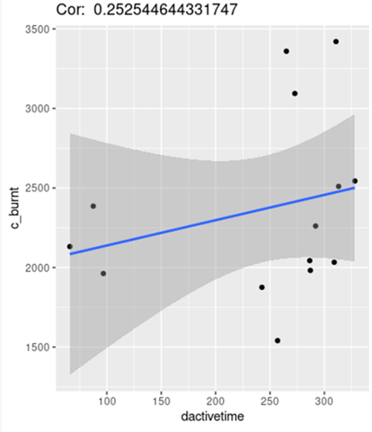
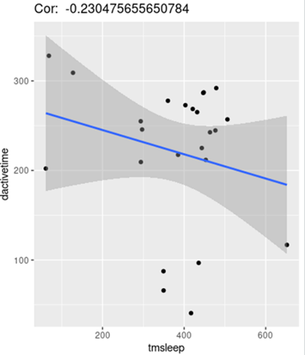
5.Data Analysis /Conclusions

Slide 10

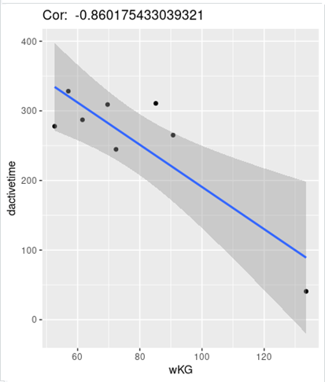
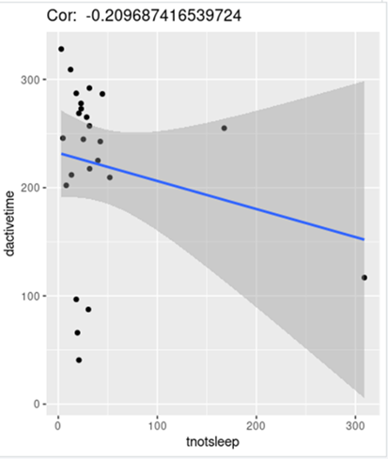
5.Data Analysis /Conclusions

Slide 11
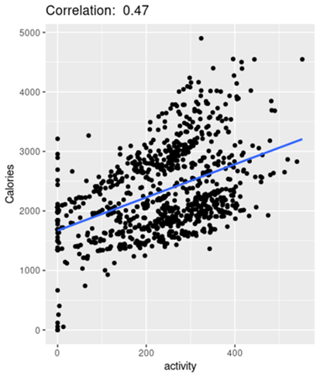
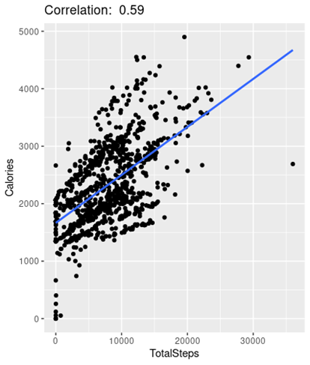
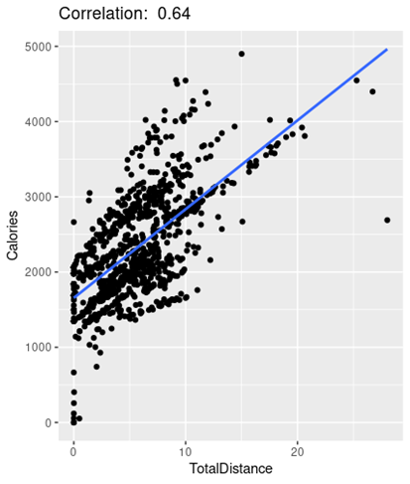
5.Data Analysis /Conclusions

Slide 12
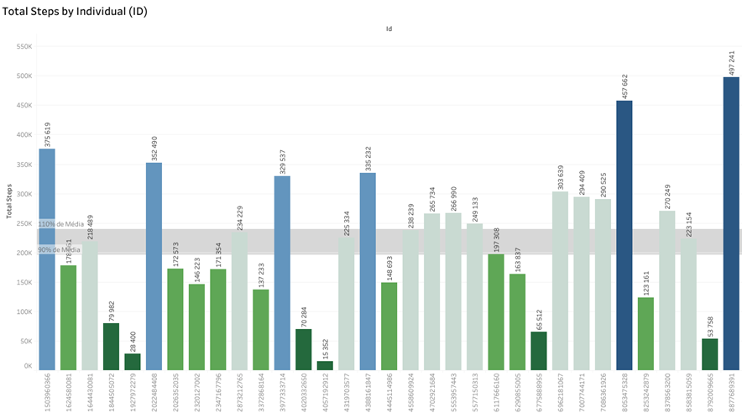
5.Data Analysis/Conclusions – Using Tableau

Slide 13
6.Recommendations
Gather more data
Not all users enjoy the full capabilities of the device
Make it user-friendly
Easy connection – long life battery
Create acessories
Immersive relation between user – app – device

Slide 14
6.Recommendations
Activity builds life quality
Signal
Goals
Inspire
Measure

Slide 15
Being in constant interaction and support of our customers can make them feel supported and encouraged to go further. So, it’s important to show how he can improve and reach their goals

Slide 16

Thank you for your time

